Slide 1


<Annie>
<Mar.18.2024>

Slide 2

Outline
Executive Summary
Introduction
Methodology
Results
Conclusion
Appendix

Slide 3
Executive Summary
Summary of methodologies
The methods cover the areas from data collection, data wrangling, explortory data analysis through data visualization and database queries, to interactive visual analysis and predictive analysis using varias models
Summary of all results
By analyzing spacex launching data, variant of factors impacting the launch landing success rate are identified. Note that the overall success rate are increasing over the years.

Slide 4
Introduction
This is final assignment of the IBM Applied Data Science Capstone Course.
This presentation includes descriptions and results from a series of hands-on labs in the course.
The data is spacex launching data, main objective is to identify and analyze the key factors may impact the launch landing success rate.
The methods cover the areas of data collection, data wrangling, explortory data analysis through data visualization and database queries, as well as interactive visual analysis and predictive analysis using varias models

Slide 5

Section 1

Slide 6
Methodology
Executive Summary
Data collection methodology:
Data are requested through spacex API, then the data in the response are parsed and convert to dataframe
Perform data wrangling
raw data are transformed and re-structured for further analysis, including filter out un-needed data, replace missing data with mean, as well construct new label for landing outcome for further landing analysis.
Perform exploratory data analysis (EDA) using visualization and SQL
Perform interactive visual analytics using Folium and Plotly Dash
Perform predictive analysis using classification models
How to build, tune, evaluate classification models

Slide 7
Data Collection – SpaceX API
SpaceX data are collected by invoking API. HTTP Requests are sent to remote website to request spaceX data. JSON data in Response are decoded, spaceX data are extracted and converted to dataframe.
Data then be filtered to only include Falcon 9 data. Also the missing values in the data frame are replaced with average value.
GitHub URL of the completed SpaceX API calls notebook:
https://github.com/annie20230519/Data-Science-Coursera-Assignment/blob/main/jupyter-labs-spacex-data-collection-api.ipynb
dat= requests.get(static_json_url)
results= json.loads(dat.text)
pd.DataFrame(results)
data= pd.json_normalize(results)
......
HTTP requests.get
local Client
remote URL
(with spaceX data)
JSON data (SpaceX data)

Slide 8
Data Collection - Scraping
SpaceX data are requested through HTML request, and the response data are parsed by beautifulSoup(). Spacex data are then extracted by further parsing HTML tables and converted to dataframe.
GitHub URL of the completed web scraping notebook:
https://github.com/annie20230519/Data-Science-Coursera-Assignment/blob/main/jupyter-labs-webscraping.ipynb
HTML Request
local
Remote Website with spaceX data
HTML Response DATA
data = requests.get(static_url).text
table= BeautifulSoup(data, "html.parser")

Slide 9
Data Wrangling
Exploratory Data Analysis using data wrangling, raw data are transformed and re-structured for further analysis, the following are calculated,
the number of launches on each site
the number and occurrence of each orbit
the number and occurence of mission outcome of the orbits
And finally a landing outcome label is created for success/failure analysis
GitHub URL of completed data wrangling related notebooks, as an external reference
https://github.com/annie20230519/Data-Science-Coursera-Assignment/blob/main/labs-jupyter-spacex-Data%20wrangling.ipynb

Slide 10
EDA with Data Visualization
The scatter graphs are plotted to analyze the potential correlation factors and how they impact the launch outcome,
Flight number (representing launch events in time sequence) and Payload
Flight number and launch site
Payload and launch site
Success rate and orbit type
Flight number and orbit type
Payload and orbit type
and finally yearly success rate trend is demonstrated using bar chart
GitHub URL of completed EDA with data visualization notebook,
https://github.com/annie20230519/Data-Science-Coursera-Assignment/blob/main/jupyter-labs-eda-dataviz.ipynb

Slide 11
EDA with SQL
The following SQL queries are performed,
Names of the unique launch sites in the space mission
Launch sites begin with the string 'CCA'
Total payload mass carried by boosters launched by NASA (CRS)
Average payload mass carried by booster version F9 v1.1
Date of the first succesful landing in ground pad.
Boosters successful land in drone ship with payload mass between 4000 and 6000
Booster_versions carried the maximum payload mass.
Total number of successful and failure mission outcomes
records display the month names, failure landing_outcomes in drone ship ,booster versions, launch_site for the months in year 2015
Rank the count of landing outcomes between 2010-06-04 and 2017-03-20
GitHub URL of completed EDA with SQL notebook,
https://github.com/annie20230519/Data-Science-Coursera-Assignment/blob/main/jupyter-labs-eda-sql-coursera_sqllite.ipynb

Slide 12
Build an Interactive Map with Folium
The following are added to a folium map
Marked all launch sites with circles on a map using Folium
Marked the success/failed launches for each site on the map using Folium markerCluster()
Calculate the distances between a launch site to its proximities
GitHub URL of completed interactive map with Folium map,
https://github.com/annie20230519/Data-Science-Coursera-Assignment/blob/main/lab_jupyter_launch_site_location_spacex.ipynb

Slide 13
Build a Dashboard with Plotly Dash
Created interactive dashboard, so that it can show
Launch Site Drop-down to select each site or all sites
Pie chart of success launches for all sites; or success launches for each site.
Payload and success corelation scatter chart plot for each site or all sites, with adjustable range of payload, adjust by a range slider.
GitHub URL of completed Plotly Dash lab,
https://github.com/annie20230519/Data-Science-Coursera-Assignment/blob/main/dash_interactive_spacex.ipynb

Slide 14
Predictive Analysis (Classification)
The model development process is demonstrated in the flowchart.
The following models are analized, and best parameter and score for each model is given.
Logistic Regression
Support Vector Machine
Decision Tree
Nearest Neighbor
GitHub URL of completed predictive analysis lab,
https://github.com/annie20230519/Data-Science-Coursera-Assignment/blob/main/SpaceX_Machine_Learning_Prediction_Part_5.jupyterlite.ipynb
Data Pre-Processing
(e.g. scaling using StandardScaler)
Split data set to
training set and test set
Choose Model, Create Model Object
(e.g. Logistic Regression)
define parameter set for optimization
GridSearch() run through all parameters on traing set
find the best parameter and score
Evaluate the score on test set using the selected best parameter
Plot confusion matrix to better assess skew dataset

Slide 15
Results
Exploratory data analysis results
Interactive analytics demo in screenshots
Predictive analysis results

Slide 16

Section 2

Slide 17
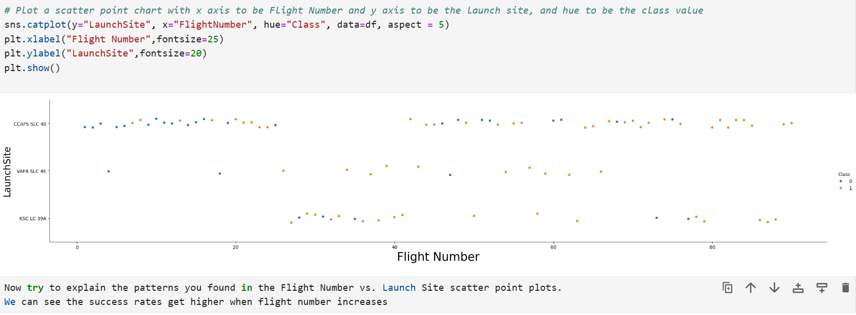
Flight Number vs. Launch Site
Scatter plot of Flight Number vs. Launch Site

Slide 18
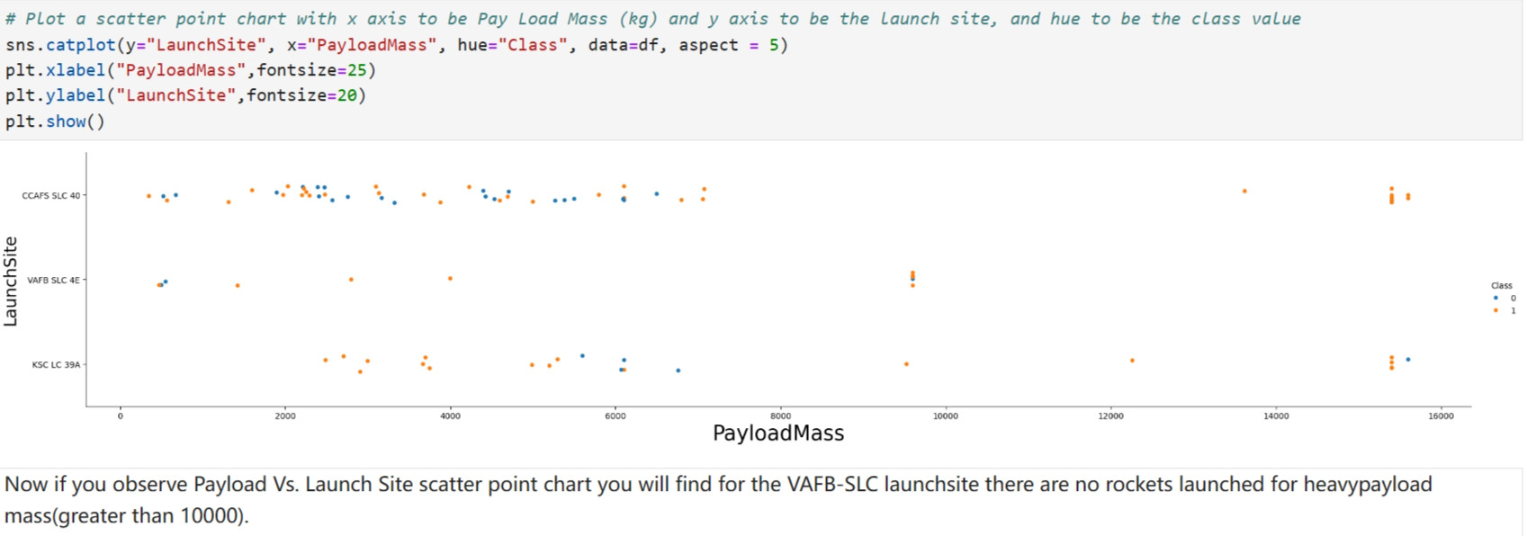
Payload vs. Launch Site
Scatter plot of Payload vs. Launch Site

Slide 19
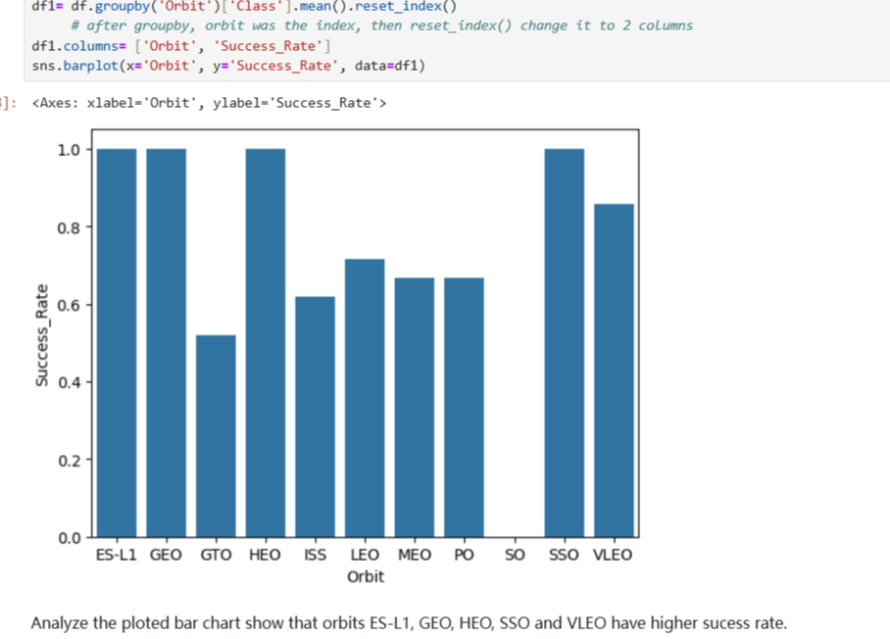
Success Rate vs. Orbit Type
Bar chart for the success rate of each orbit type

Slide 20
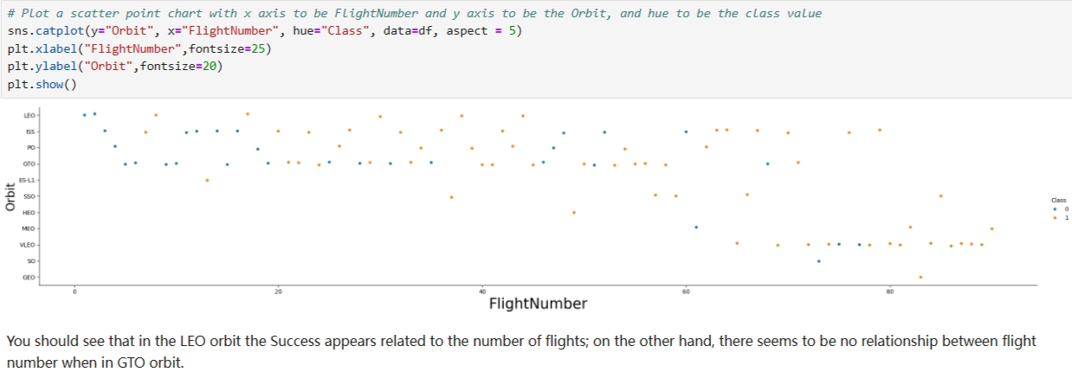
Flight Number vs. Orbit Type
Scatter plot of Flight number vs. Orbit type

Slide 21
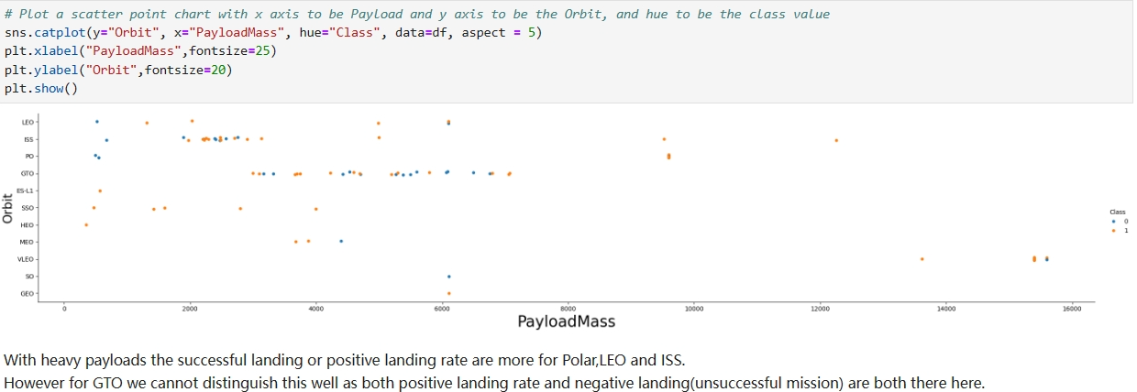
Payload vs. Orbit Type
Scatter plot of payload vs. orbit type

Slide 22
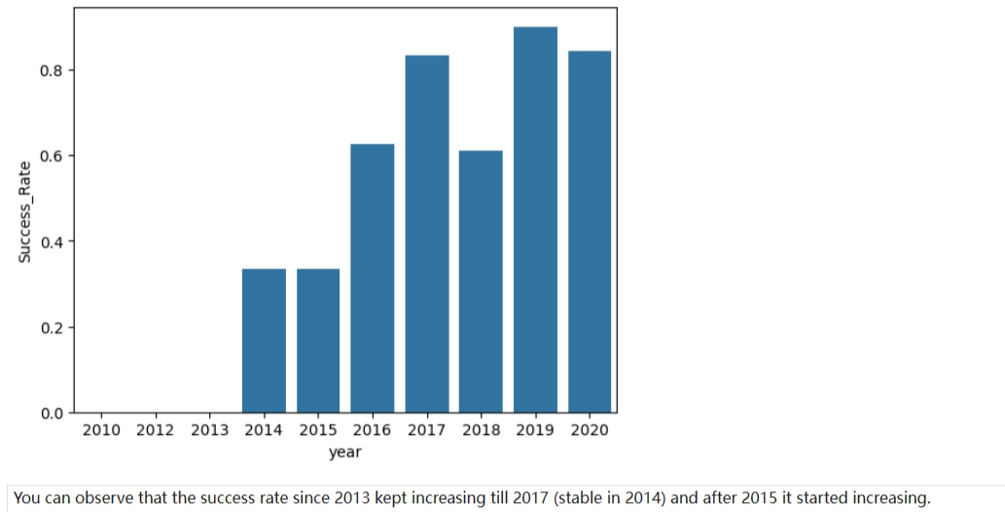
Launch Success Yearly Trend
Line chart of yearly average success rate

Slide 23
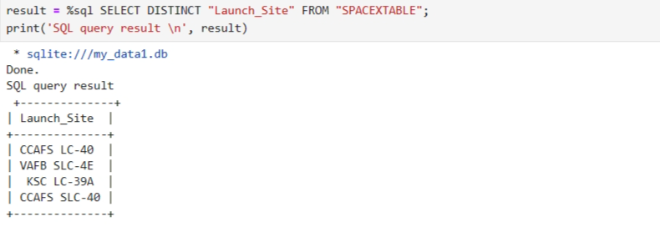
All Launch Site Names
Launch site names by SQL query

Slide 24
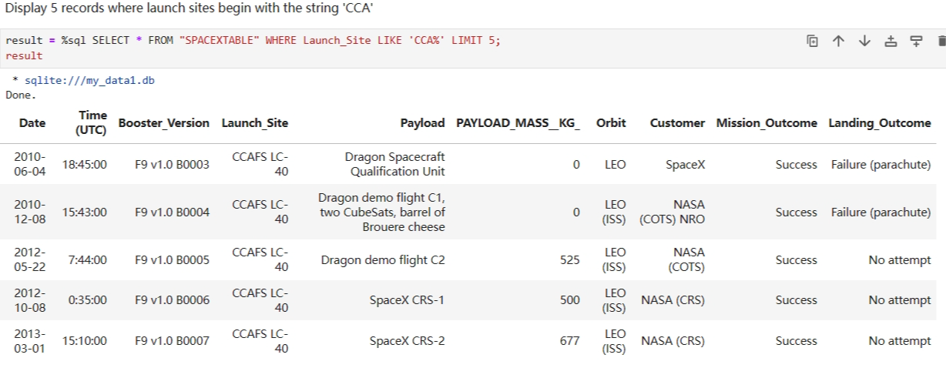
Launch Site Names Begin with 'CCA'
Find 5 records where launch sites begin with `CCA`

Slide 25
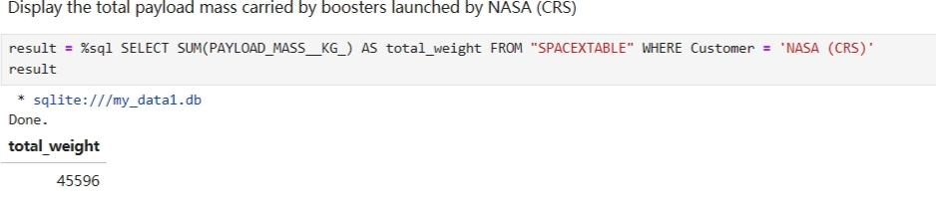
Total Payload Mass
Calculate the total payload carried by boosters from NASA

Slide 26
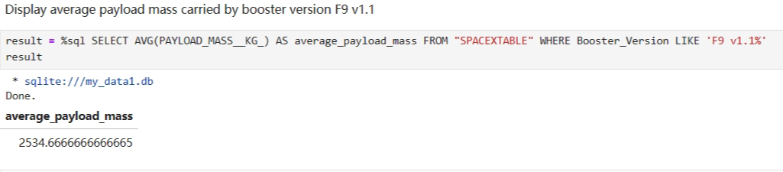
Average Payload Mass by F9 v1.1
Calculate the average payload mass carried by booster version F9 v1.1

Slide 27
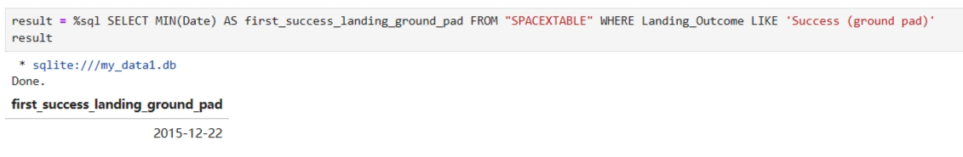
First Successful Ground Landing Date
The dates of the first successful landing outcome on ground pad

Slide 28
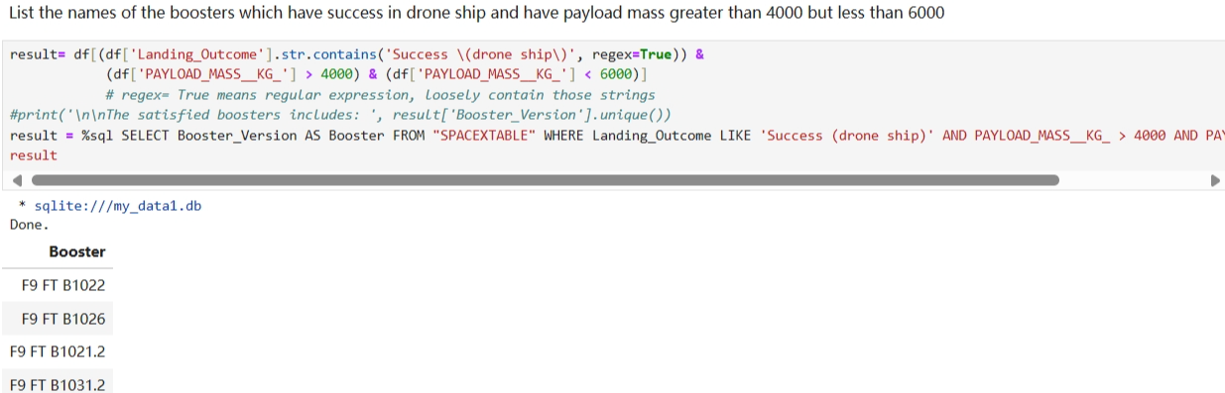
Successful Drone Ship Landing with Payload between 4000 and 6000
The names of boosters which have successfully landed on drone ship and had payload mass greater than 4000 but less than 6000

Slide 29
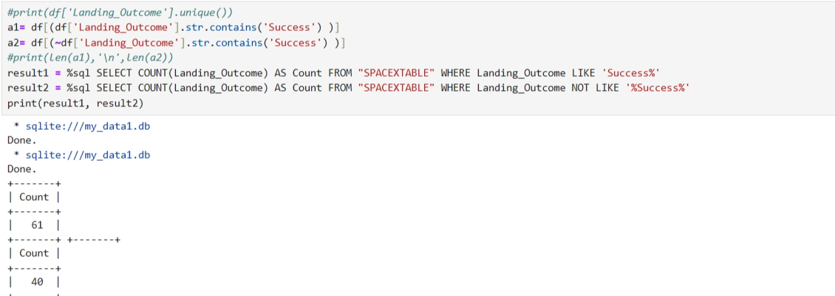
Total Number of Successful and Failure Mission Outcomes
Calculate the total number of successful and failure mission outcomes

Slide 30
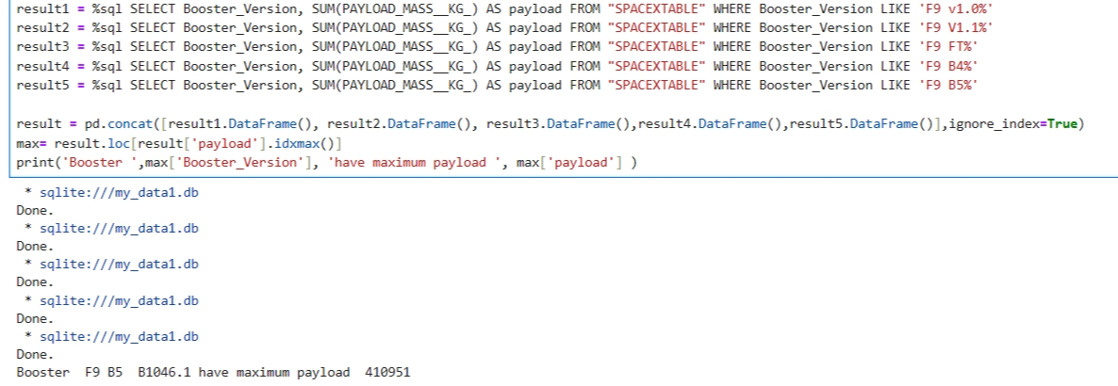
Boosters Carried Maximum Payload
Names of the booster which have carried the maximum payload mass

Slide 31
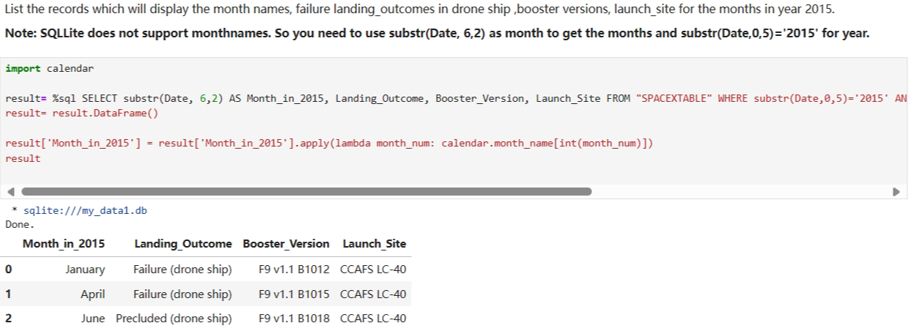
2015 Launch Records
The failed landing_outcomes in drone ship, their booster versions, and launch site names for in year 2015

Slide 32
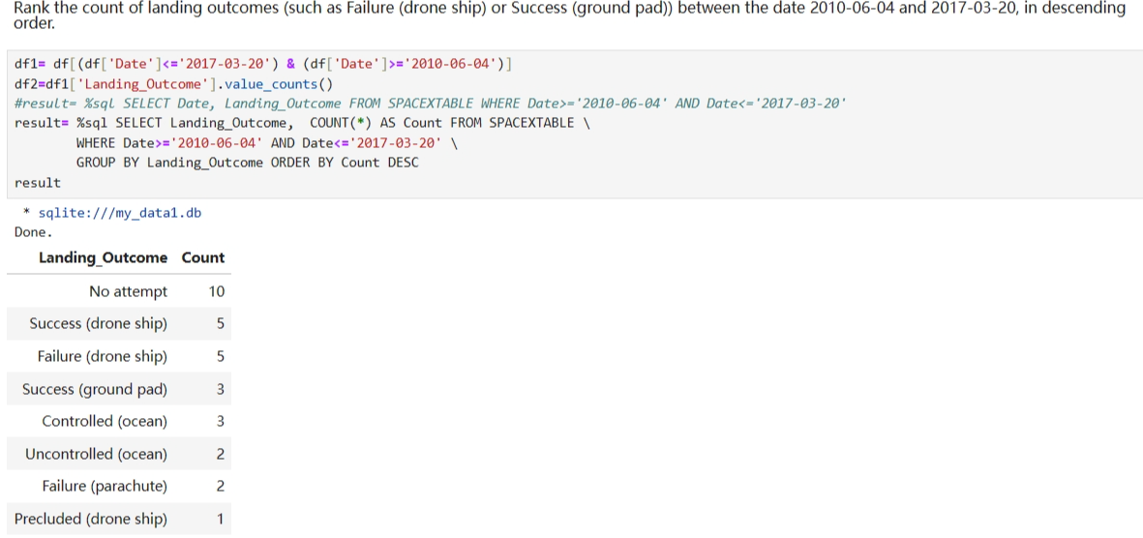
Rank Landing Outcomes Between 2010-06-04 and 2017-03-20
Rank the count of landing outcomes between 2010-06-04 and 2017-03-20

Slide 33

Section 3

Slide 34
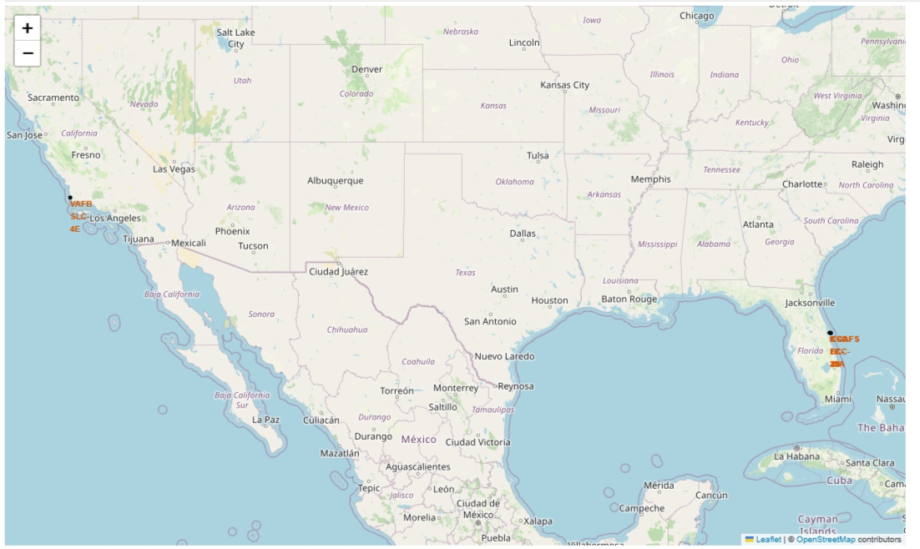
<Folium Map with launch sites location>
This screenshot shows all launch sites’ location markers on a global map. There are 3 sites on the east coast and 1 on the west coast

Slide 35
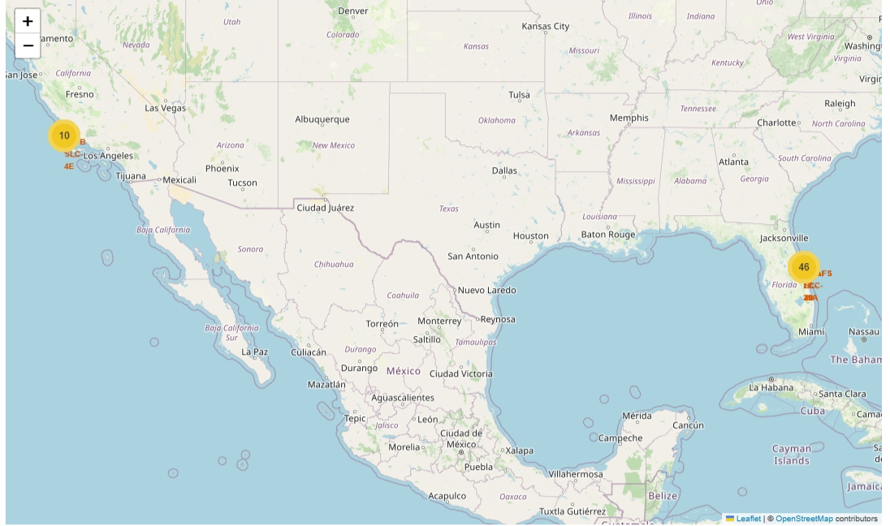
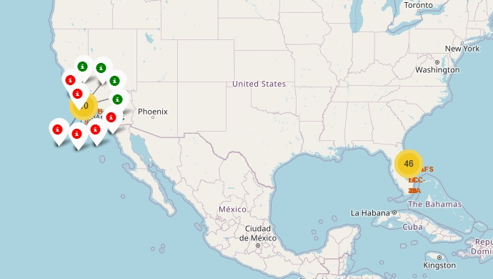
Folium Map with color-labeled launch outcomes
The folium map with color-labeled launch outcomes on the map are shown below.
Note that both success and failure launches for a site are shown when click on the site

Slide 36

Section 4

Slide 37
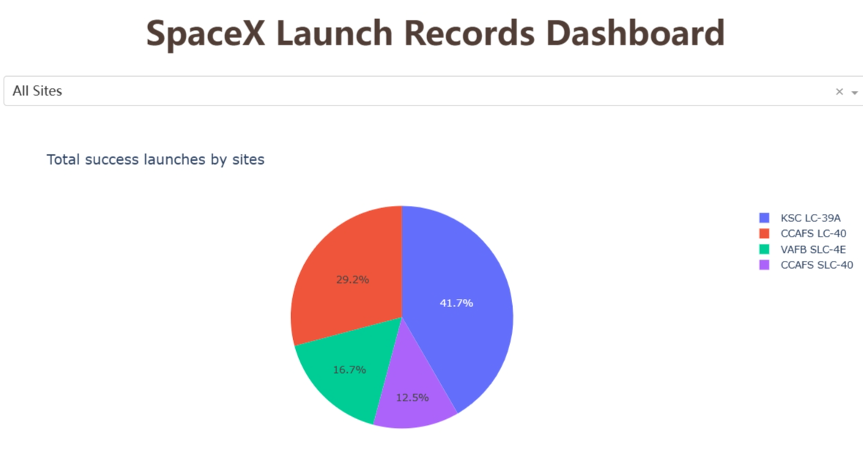
Launch success count
Launch success count for all sites is shown in the pie chart when select ‘All Sites’ in the dashboard drop down

Slide 38
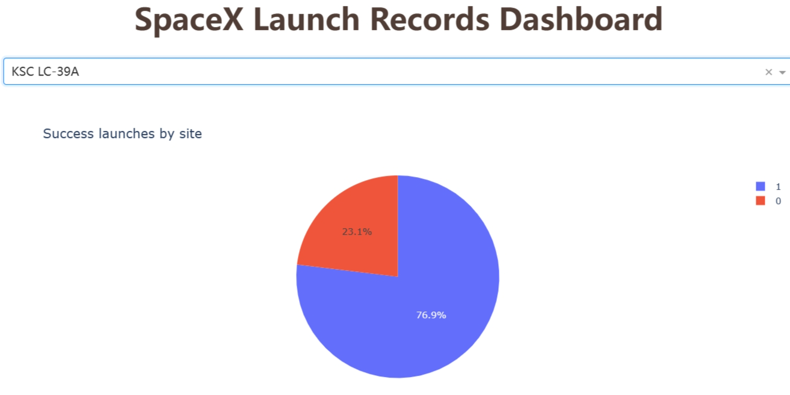
<launch site with highest launch success ratio>
Piechart for each launch site success ratio can be viewed when the site is selected in the dropdown.
The following demostrate the launch site with highest launch success ratio

Slide 39
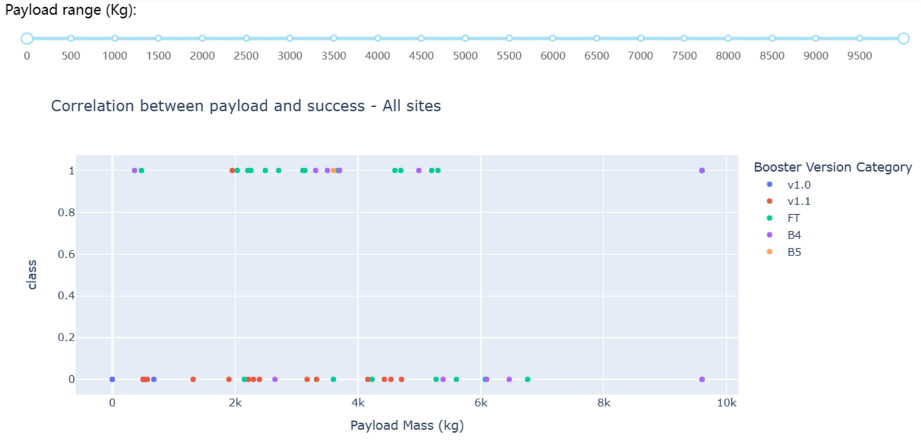
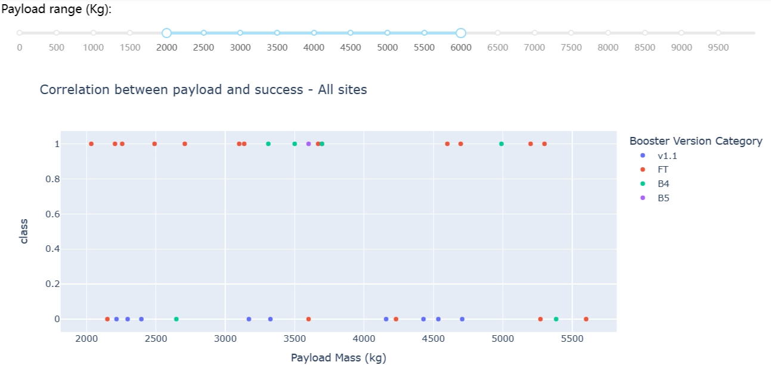
<Scatter plot with payload-adjustable range slider>
Payload vs. Launch Outcome scatter chart can be viewed for all sites
The chart can be viewed in a specific payload range, adjustable by a payload range slider
The following charts demonstrated all payload range, and payload range 2000 to 6000 case.

Slide 40

Section 5

Slide 41
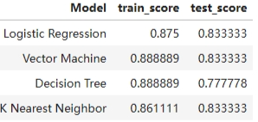
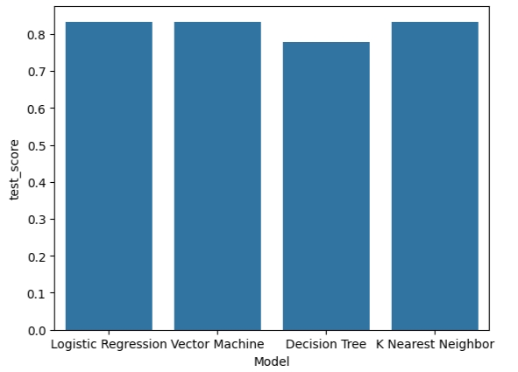
Classification Accuracy
The accuracy for all built classification models can be visualized in the following charts
Support Vector Machine model has the highest classification accuracy

Slide 42
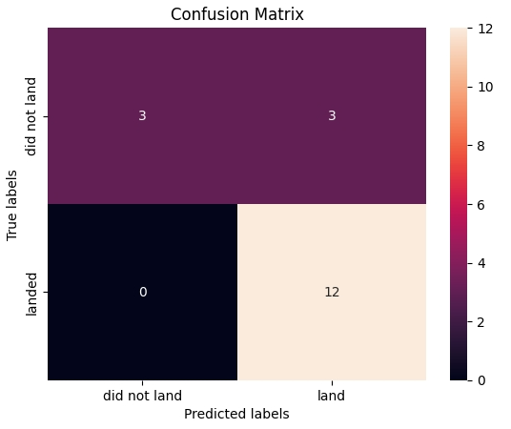
Confusion Matrix
The confusion matrix of the Support Vector Machine

Slide 43
Conclusions
Success rate are increasing over the year

Slide 44


